Slide 1
Security Evaluation of Home-Based IoT Deployments
CS 595 Paper Presentation
Sainath Macharla

Slide 2
Contents
Introduction
Motivation
Approach
Evaluation
Results
Limitations
References

Slide 3
Introduction
Demand for IoT devices
Attacks
High profile
Mass exploitation of devices
Exotic device hacking
Priority - time to market, production costs over security
Not standard solution
Heterogenous
Same core functionalities
Specific features based on device type

Slide 4
Introduction
Backdoors
DDoS attacks
Not enough vulnerability patching after the fact

Slide 5
Motivation
Regular use in daily life
Urge to have privacy
Unification of research
Public portal to share evaluation data
Invitation for the community to contribute

Slide 6
Approach
Systematization
Evaluate IoT devices
Abstract models - IoT deployments into components
45 IoT devices are tested and results shared

Slide 7
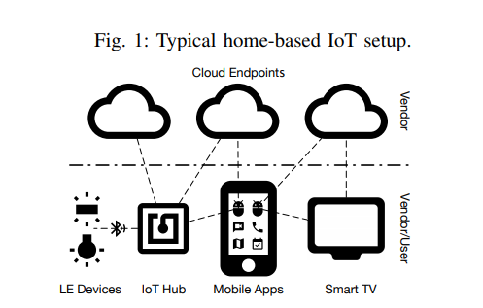
Abstract Model

Slide 8
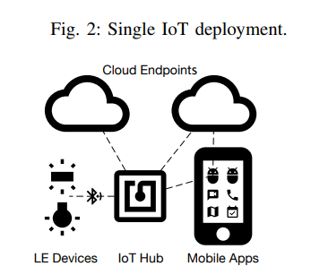
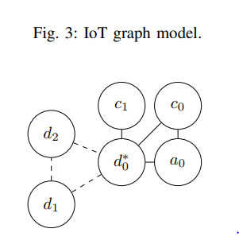

Slide 9
Security
Attack vectors
Vulnerable services
Weak authentication
Default configuration
Mitigation
Patching
Framework
Stakeholders
Vendor
End User

Slide 10
Systematization
Uniformity
Identifying
Attack techniques
Proposed mitigations
Stakeholder responsibilities

Slide 11
Evaluation scope & Attack Model
Home based IoT devices
IP network attacker
No LE devices
Hub (communication b/w LE and IP) considered
Home network - untrusted
Mobile apps, modems/routers, web browsers - no assumption

Slide 12
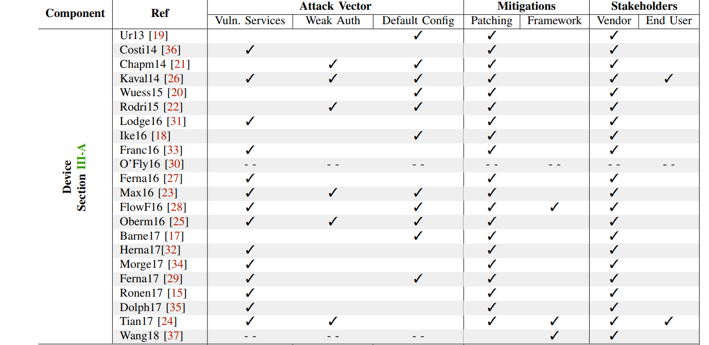

Slide 13
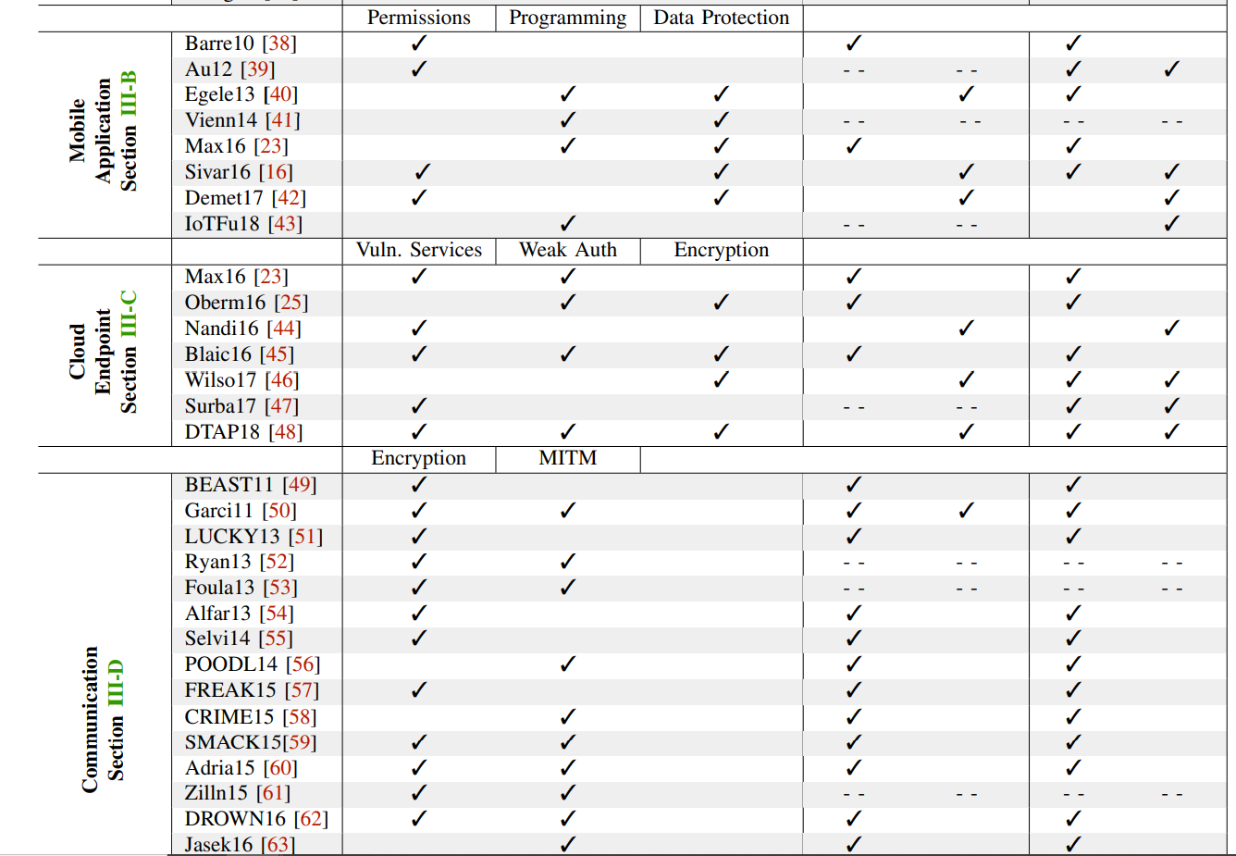

Slide 14
Attack Vector
Barnes - exposed hardware pins, gain privilege access and spy on end users
Insecure configuration and weak authentication
Device setup and configuration
August smart lock - weak auth and insecure config
Cloud based cameras - password
SONOS
LE devices - IP networks via IoT hubs
Philips Hue

Slide 15
Mitigations
Software patches
Initial configuration
New frameworks

Slide 16
Stakeholders
Vendor responsible for patching and updating
Implementation of services
Third party authorization
Privileged access

Slide 17
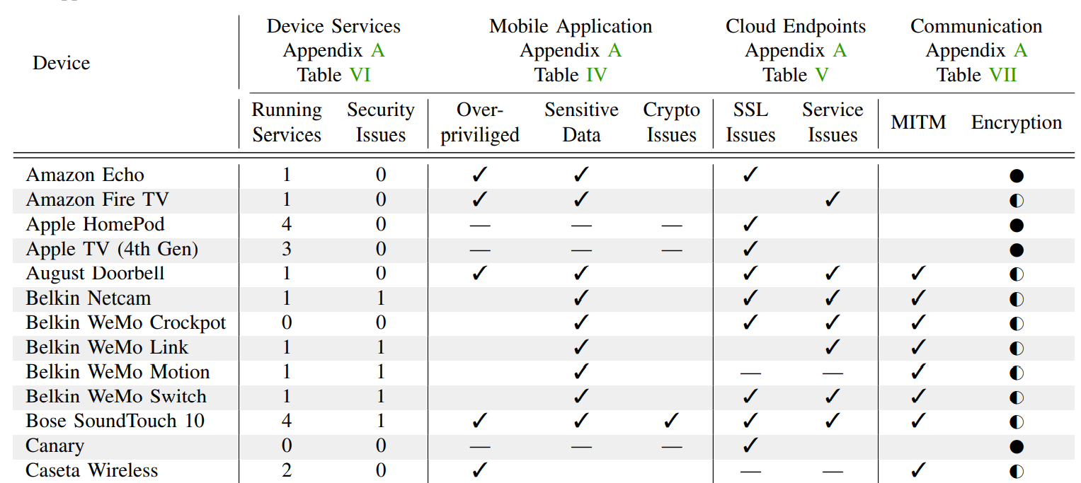

Slide 18
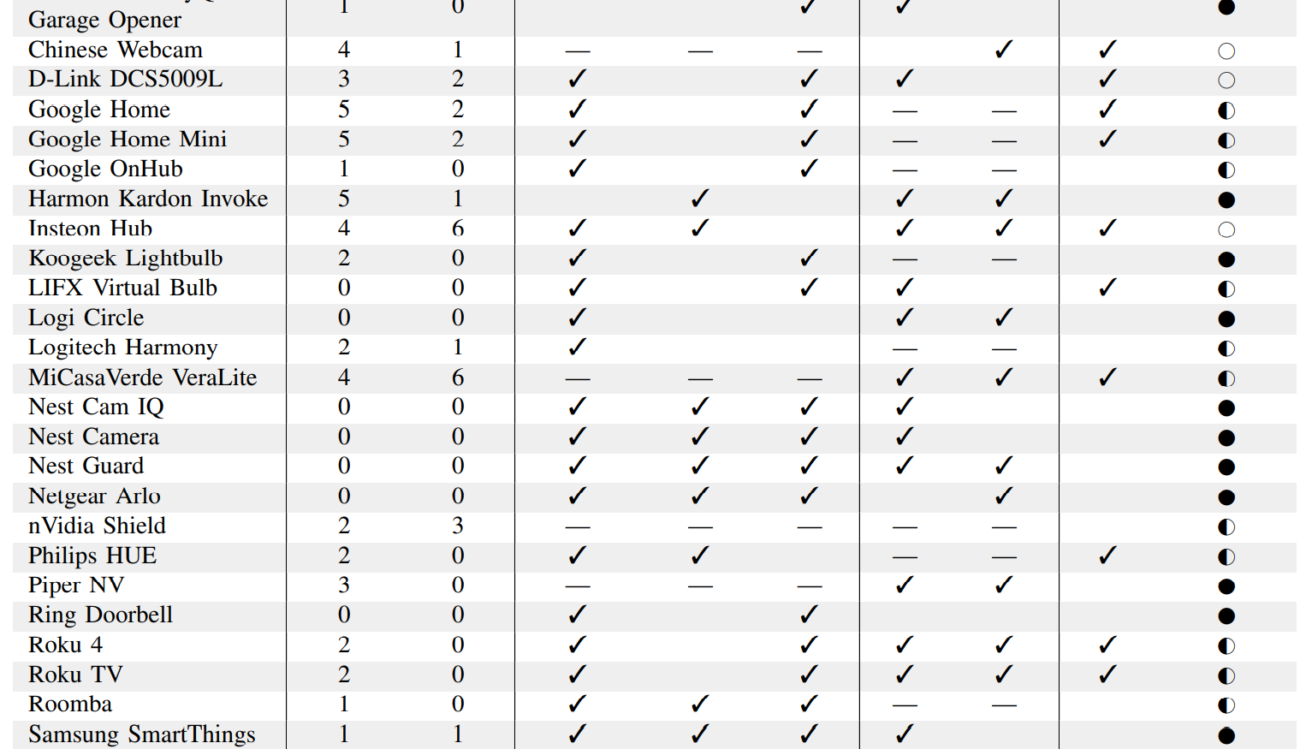

Slide 19
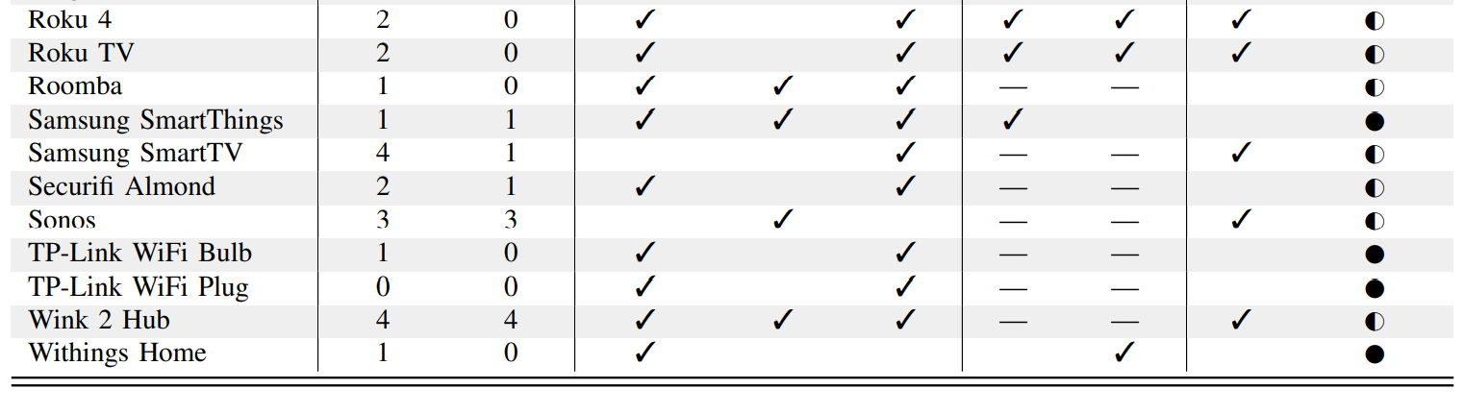

Slide 20
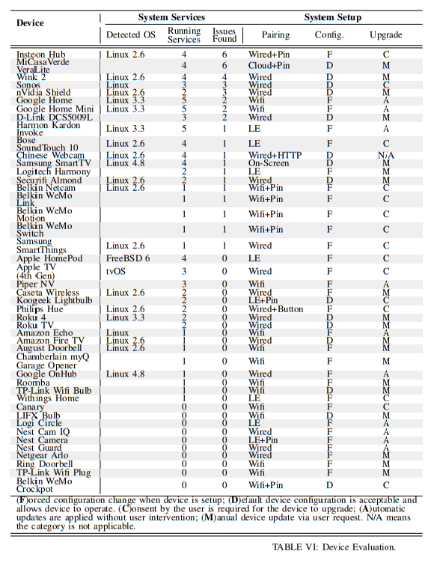

Slide 21
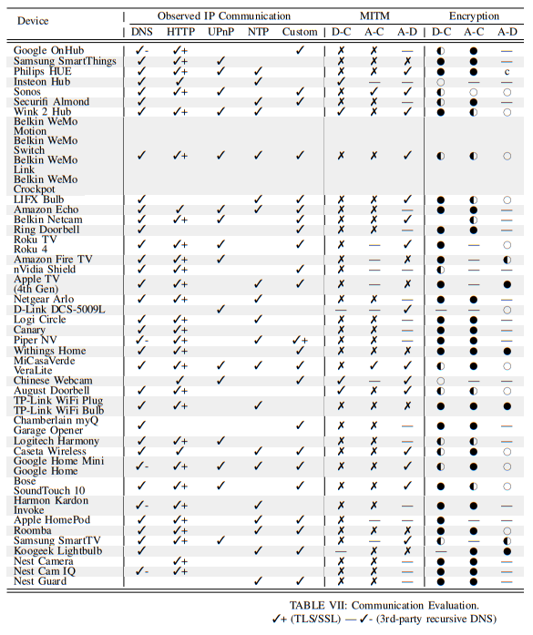

Slide 22
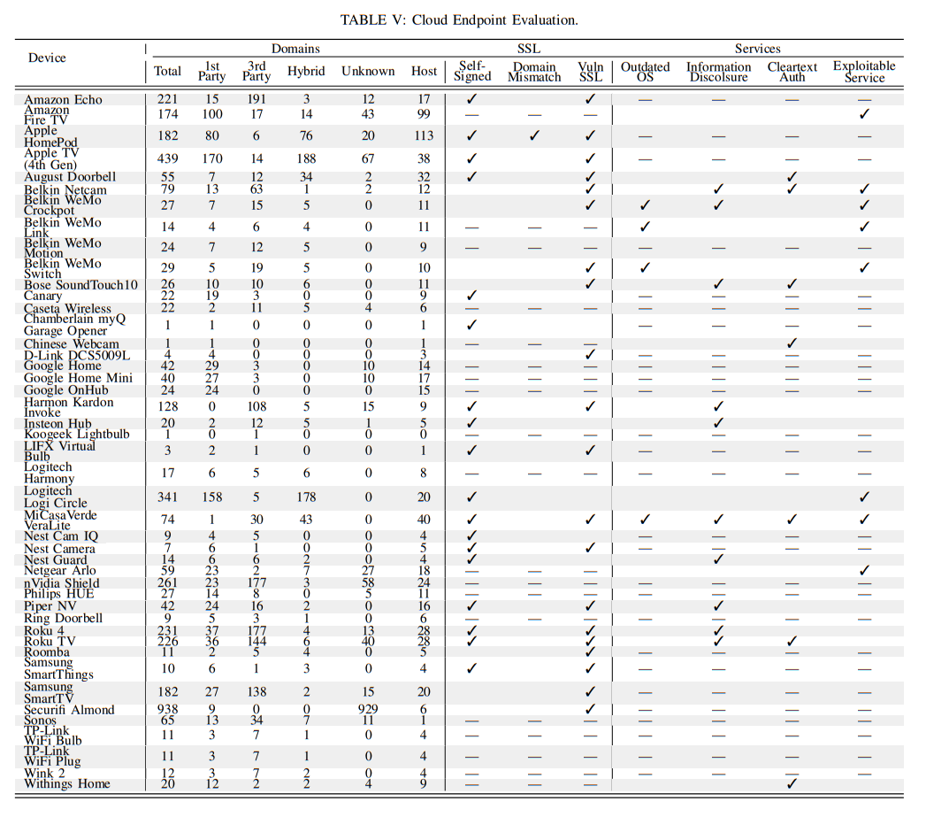

Slide 23
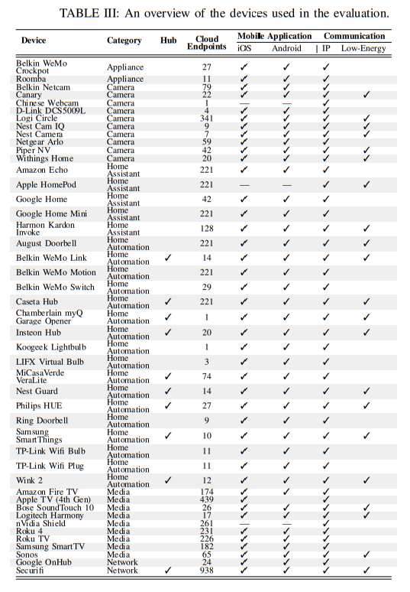

Slide 24
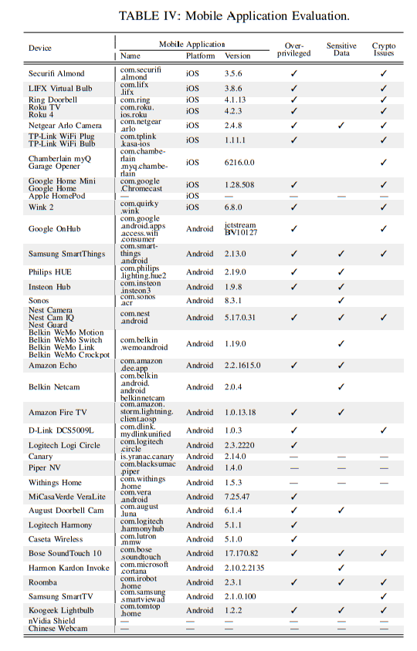

Slide 25
Limitations
Focused only on home IoT devices
Relies heavily on peer work than original

Slide 26
References
1 ) C. Cimpanu, Over 65,000 Home Routers Are Proxying Bad Traffic for Botnets, APTs, https://www.bleepingcomputer.com/news/security/ over- 65- 000- home- routers- are- proxying- bad- traffic- for- botnetsapts/, 2018.
2) M. Antonakakis, T. April, M. Bailey, M. Bernhard, E. Bursztein, J. Cochran, Z. Durumeric, J. A. Halderman, L. Invernizzi, M. Kallitsis, D. Kumar, C. Lever, Z. Ma, J. Mason, D. Menscher, C. Seaman, N. Sullivan, K. Thomas, and Y. Zhou, “Understanding the mirai botnet,” in Proc. 26th USENIX Sec., Vancouver, BC, Canada, Aug. 2017.
3) O. Williams-Grut, Hackers once stole a casino’s high-roller database through a thermometer in the lobby fish tank, http://www.businessin sider.com/hackers-stole-a-casinos-database-through-a-thermometerin-the-lobby-fish-tank-2018-4, 2018.

Slide 27
4) Unlocking the potential of the internet of things, http://www.mckinse y.com/business-functions/digital-mckinsey/our-insights/the-internetof-things-the-value-of-digitizing-the-physical-world, 2015.
5) IPSO Alliance, http://www.ipso-alliance.org/, 2016.
6) AllSeen Alliance, https://allseenalliance.org/, 2016.
7) AllJoyn Framework, https://allseenalliance.org/framework, 2016.
8) Wikipedia - Open Connectivity Foundation, https://en.wikipedia.org/ wiki/Open Connectivity Foundation, 2016.
9) Industrial Internet Consortium (IIC), https://www.iiconsortium.org, 2016.

Slide 28
10) Thread Group, https://threadgroup.org, 2016.
11) Standard for an Architectural Framework for the Internet of Things (IoT), http://grouper.ieee.org/groups/2413, 2016.
12) IoTivity, https://www.iotivity.org, 2016.
13) B. Rodrigues, LuaBot: Malware targeting cable modems, https : / / w00tsec. blogspot. com/ 2016/ 09/luabot - malware - targeting - cable - modems.html, 2016.
14) Yegenshen, Iot reaper: A rappid spreading new iot botnet, http://blog. netlab.360.com/iot reaper- a- rappid- spreading- new-iot- botnet- en/, 2017.

Slide 29
Thank You

